Slide 1
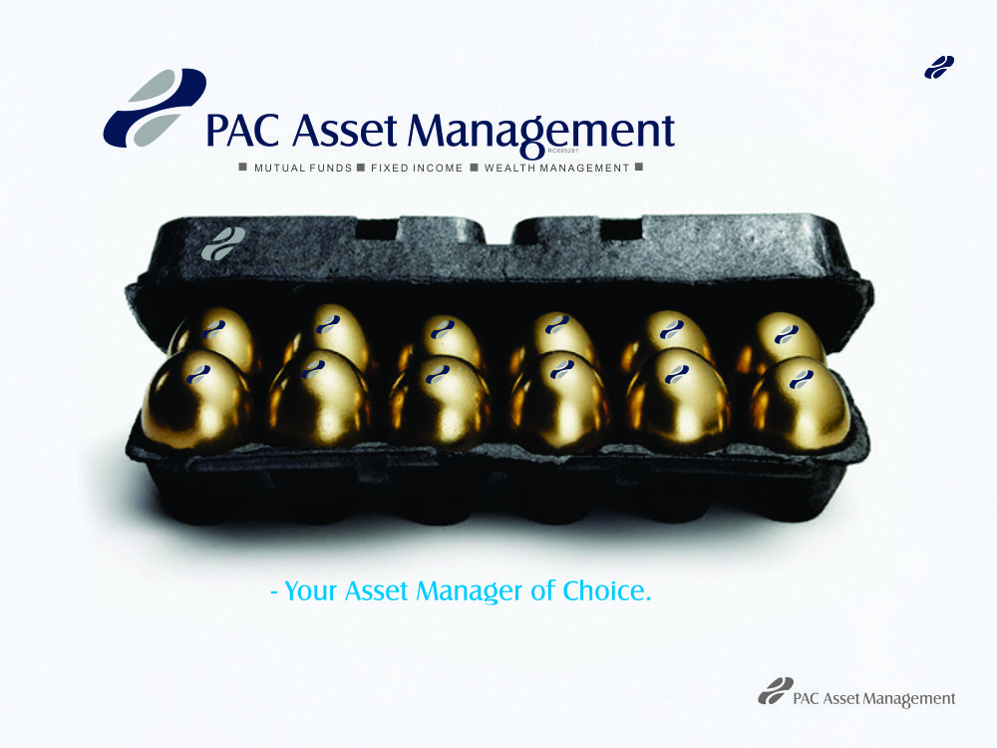

Slide 2


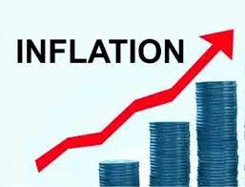

Monthly Fund Manager’s Report – February 2025
February 2025 Market & Economic Review
MONETARY POLICY – The MPC held its first meeting of 2025 in February and decided to retain the Monetary Policy Rate (MPR) at 27.50%. The Cash Reserve Ratio (CRR) remains at 50.00% for commercial banks and 16.00% for merchant banks, while the Liquidity Ratio stays at 30.00%. The asymmetric corridor was also maintained at +500bps/-100bps.
CRUDE OIL: The NUPRC report for February is yet to be released. However, according to the NUPRC report for January, Nigeria’s average daily liquid production rose to 1.74 mbpd in January 2025, marking a 4.19% increase from 1.67 mbpd recorded in December 2024. A breakdown of the January production data shows that the country produced 1.54 mbpd of crude oil, 61,620 bpd of blended condensates, and 137,164 bpd of unblended condensates, bringing total output to 1.74 mbpd for the month. Meanwhile, Brent crude prices declined in February, dropping to $74.78 per barrel from $78.19 in January 2025. The drop was driven by increased global supply and softer demand in key international markets, despite the ongoing geopolitical tensions. These factors exerted downward pressure on oil prices throughout the month.
FOREIGN EXCHANGE: On the Investors and Exporters (I&E) Window, the naira depreciated by ₦14.27 (0.97%) in February, closing at ₦1,492.49/$ compared to ₦1,478.22/$ in January 2025. This decline was driven by fluctuations in the global market, including changes in oil prices and geopolitical tensions, which affected Nigeria's foreign exchange earnings. Additionally, market adjustments following the inflation rebasing and increased demand for foreign currency contributed to the modest weakening of the naira.
MACROECONOMIC OVERVIEW
GROSS DOMESTIC PRODUCT (GDP):According to recent data from the National Bureau of Statistics (NBS), Nigeria’s GDP grew by 3.84% year-on-year in real terms in Q4 2024, surpassing both the 3.46% recorded in Q4 2023 and the Q3 2024 growth rate of 3.46%. The Services sector led the expansion, growing by 5.37% and contributing 57.38% to total GDP. The Agriculture sector recorded a 1.76% growth, slightly lower than the 2.10% in Q4 2023, while the Industry sector grew by 2.00%, down from 3.86% in the same period. The Services sector’s contribution to GDP was higher in Q4 2024 compared to Q4 2023. Average daily crude oil production edged up to 1.54 million barrels per day (mbpd) in Q4 2024, compared to 1.47 mbpd in Q3 2024 but slightly below the 1.56 mbpd recorded in Q4 2023. However, production remained well below the 2024 budget target of 1.78 mbpd and the 13-quarter peak of 1.57 mbpd in Q1 2024. Growth in the non-oil sector was mainly driven by Financial and Insurance (Financial Institutions), Information and Communication (Telecommunications), and Agriculture (Crop Production), among others. Overall, Nigeria’s annual GDP growth stood at 3.40%, improving from 2.74% in 2023.
INFLATION: Nigeria’s headline inflation declined to 24.48% in January 2025 down from 34.80% in December 2024, following the rebasing of the Consumer Price Index (CPI) by the National Bureau of Statistics. The new base year, adjusted from 2009 to 2024, reflects updated consumption patterns. Food inflation which continues to drive overall inflation, stood at 26.08%, while core inflation which exclude farm produce and energy came in at 22.59%. The rebasing exercise also expanded the number of items in the CPI basket from 740 to 934, offering a more detailed picture of current inflationary pressures and consumption spending habits in Nigeria.
OUTLOOK: Following the CPI rebasing exercise, we expect inflation to decline near term, supported by naira stability and lower energy prices. Future data under the revised CPI should clarify inflation trends. The MPR is currently at 27.5% and is expected to remain unchanged until the next MPC meeting in May, barring any policy adjustments. Economic growth is projected to improve, driven by both oil and non-oil sectors. GDP rebasing and the expanded CPI basket (740 to 960 items) will provide a clearer outlook. The exchange rate is expected to stabilize as the CBN enhances market interventions like EFEM and the new FX code.

Slide 3
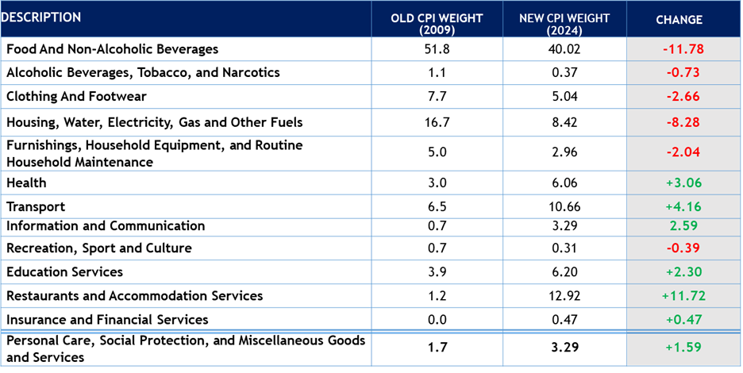
Monthly Fund Manager’s Report – February 2025
February 2025 Market & Economic Data
Source: NGX, CBN, PAC Research

Slide 4


Monthly Fund Manager’s Report – February 2025
February 2025 Market & Economic Review
DEBT MARKET OVERVIEW
EQUITIES MARKET OVERVIEW
BONDS: In the secondary bond market, the average yield on FGN Bonds declined by 215bps, closing at 18.47% in February, compared to 20.63% in January 2025. By the end of the month, the yields on the 2-year, 4-year, 8-year, and 25-year bonds stood at 19.37% (-157bps), 19.13% (-247bps), 18.79% (-335bps), and 17.27% (-56bps), respectively.
TREASURY BILLS:The average yield in the secondary market for T-bills declined by 334bps m/m to 19.85% from 23.19%, reflecting sustained bullish sentiment in February, in line with our expectations. The yields on the 91-day (-299bps), 180-day (-250bps), and 360-day (-555bps) bills also declined over the period.
OUTLOOK: We anticipate sustained strong demand for debt instruments as market participants seek to take advantage of attractive yields in both primary auctions and the secondary market. Investors are likely to lock in higher rates ahead of a potential decline, driven by expectations of easing inflation and stable interest rates.
In February 2025, the equities market closed on a bullish note as the All-Share Index (ASI) and market capitalization rose by 3.18% and 3.83%, respectively, to close at 107,821.39 points and ₦67.19 trillion (vs. January 2025: 104,496.10 points and ₦64.71 trillion). The rally was largely driven by positive investor sentiment surrounding the release of FY’2024 financial statements of listed companies on the NGX. Consequently, the month-to-date and year-to-date return of the index stood at 3.18% and 4.76% respectively.
The top gainers for the month were SMURFIT (+65.00%), PZ (+53.91%), and UPDC (+53.48%). On the other hand, the top losers included UNIONDICON (-28.00%), EUNISELL (-27.30%), and LEARNAFRCA (-26.67%).
OUTLOOK: In March 2025, the Nigerian equity market will likely be influenced by corporate earnings releases, dividend declarations, and macroeconomic trends. Positive investor sentiment may persist, but profit-taking on high-performing stocks could trigger market corrections. Interest rates and inflation data will also play a key role in shaping market direction.
Source: NGX, PAC Research
Source: Bloomberg, PAC Research

Slide 5
PACAM MONEY MARKET FUND 29 Febriuary-2025
The Fund seeks to ensure steady stream of income and capital preservation for investors with modest risk appetite who value liquidity and security of assets. The Fund will invest in low-risk short term Money Market securities such as Government securities, Bank Placement, Commercial Papers, and others which include Promissory notes.
FUND INFORMATION
Fund type | Open-ended
Category | Money Market Fund
Risk profile | Low
Launch date | 27-Jul-16
Fund Manager | PAC Asset Management Limited
Trustees | Greenwich Trustees Limited
Custodian | UBA Global Investor Services
Auditors | Sam Oyemade & Co (SOC Compliance)
Management Fee | 1% of NAV
Benchmark | 91-day Nigerian Treasury Bill
Dividend Frequency | Quarterly
5-year Annual Growth Rate | 10.36%
Dealing Days | Monday - Friday
NAV per unit (NGN) | NGN 10.00
PERFORMANCE REVIEW:
The fund closed the month with a current yield of 19.57% (January : 20.27%).
The fund saw fluctuations in the pricing of its assets resulting in a dip in the bearish sentiments. This was mainly driven by liquidity strain in the system and reduced inflation rate due to debasing.
However, we anticipate a decline in the performance of the Money Market instruments in the quarter 1, due to the rate of treasury bill and commercial paper issued during the period.
The Fund Manager continues to hold strategic positions in order to capitalize on current trends while positioning in instruments with yields.
ASSET QUALITY (% TOTAL ASSETS) | 31-Jan-25 | 28-Feb-25
Term Deposits | 6.71 | 6.71
Cash | 11.82 | 2.01
Commercial Papers | 29.95 | 24.68
Treasury Bills | 51.53 | 66.60
INVESTMENT COMMITTEE
Mr. Sam Onukwue | Chairman
Mr. Sina Alimi | Member
Mr. Bunkaya Gana | Trustee's Representative
Mr. Bamidele Ige | Fund Manager
Mrs Taiwo Sonola | Custodian
FUND RETURNS
 | Jan-25 | Feb-25
Current Yield | 20.27% | 19.57%
Inception to Date | 83.23% | 84.95%

Slide 6
PACAM FIXED INCOME FUND 29 February-2025
The objective of the Fund is to generate a steady return on capital and assured liquidity for all classes of investors. The Fund’s investments will mostly be in long tenured debt instruments of the FGN, States and highly rated corporate institutions. The Fund may also invest its assets in money market securities such as Treasury Bills, Commercial papers, Bankers Acceptances and Certificate of Deposits with rated banks in Nigeria.
FUND INFORMATION
Fund type | Open-ended
Category | Fixed Income Fund
Risk profile | Moderate
Launch date | 27-Jul-16
Fund Manager | PAC Asset Management Limited
Trustees | Greenwich Trustees Limited
Custodian | UBA Global Investor Services
Auditor | Sam Oyemade & Co (SOC Compliance)
Management Fee | 1% of NAV
Benchmark | 5-year Nigerian Sovereign Bond
Dividend Frequency | Annual
5-Year Annual Growth Rate | 0.40%
Dealing Days | Monday - Friday
NAV per unit (NGN) | NGN 12.545
PERFORMANCE REVIEW:
The m-o-m fund performance Increase by 2.16%.
Tight System liquidity coupled with an upward trend in inflation boosts the bullish run in the fixed-income space. Also, the average yield of FGN Bonds remain flat
This still presents buying opportunities as we envisage better performance in that space and encourage investors to increase their investments for better returns.
The fund manager will take current market realities into account, to provide a completely optimized portfolio.
INVESTMENT COMMITTEE
Mr. Sam Onukwue | Chairman
Mr. Sina Alimi | Member
Mr. Bunkaya Gana | Trustee's Representative
Mr. Bamidele Ige | Fund Manager
Mr Fatai Asimi | Member
Mrs Taiwo Sonola | Custodian
FUND RETURNS | Jan-25 | Feb-25
Month-on-Month | 0.90% | 0.96%
Year-to-date | 0.90% | 0.96%
Inception-to-date | 67.19% | 68.39%

Slide 7
PACAM BALANCED FUND 28 February-2025
The primary objective of PACAM Balanced Fund is to achieve long-term capital appreciation, capital preservation as well as providing a stable stream of income to investors by investing the Fund's assets across a mix of investment-grade fixed income instruments, Money Market Instruments & Real Estate Assets and high-quality listed equities on the NSE.
FUND INFORMATION
Fund type | Open-ended
Category | Balanced Fund
Risk profile | Moderate
Launch date | 15-May-15
Fund Manager | PAC Asset Management Limited
Trustees | FBN Trustees Limited
Custodian | UBA Global Investor Services
Auditors | Sam Oyemade & Co (SOC Compliance)
Management Fee | 1% of NAV
Benchmark | Composite index comprising of NSE ASI, 5-Year Nigerian Sovereign Bond, 1-Year Nigerian Treasury Bill
Dividend Frequency | Annual
6-Year Annual Growth Rate | 5.25%
Dealing Days | Monday – Friday
NAV per unit (NGN) | NGN2.77
INVESTMENT COMMITTEE
Mr. Sam Onukwue | Chairman
Mr. Sina Alimi | Member
Mr. Olufemi Okin | Trustee's Representative
Mr. Bamidele Ige | Fund Manager
Mr. Fatai Asimi | Member
Mrs Taiwo Sonola | Custodian
PERFORMANCE REVIEW:
The fund returns increased by 1.22% Y-T-D and -4.74% M-o-M, owing primarily to the equity market’s performance as the instruments held by saw significant decrease in its value during the month.
The fund manager is committed to rebalancing the fund appropriately, taking current market realities into account, to provide a completely optimized portfolio.
FUND RETURNS | Jan-25 | Feb-25
Month-on-Month | 3.54% | -1.20%
Year-to-date | 1.86% | 3.08%
Inception-to-date | 282.87% | 286.25%

Slide 8
PACAM EQUITY FUND 28 February-2025
The primary objective of PACAM Equity Fund is to achieve long-term capital appreciation by investing in high quality listed equities across sectors on the Nigerian Stock Exchange (NGX) as well as Fixed income instruments, with more concentration on equity instruments.
FUND INFORMATION
Fund type | Open-ended
Category | Equity Fund
Risk profile | High
Launch date | 20-May-19
Fund Manager | PAC Asset Management Limited
Trustees | FCMB Trustees Limited
Custodian | UBA Global Investor Services
Auditor | Adekunle Alli & Co.
Management Fee | 1% of NAV
Benchmark | NSE All Share Index
Dividend Frequency | Annual
Compounded Annual Growth Rate | -6.21%
Dealing Days | Monday - Friday
NAV per unit (NGN) | NGN 1.48
PERFORMANCE REVIEW:
The fund's performance mirrored the bearish trend in the NGX, note as the NGX All Share Index lost by 0.23% to close at 106,538.60 (against January:104,496.12),it closed at ₦2.47Billion volume traded.
The fund also saw a slight variations in its fixed income asset owing to asset pricing of the instruments held on this fund.
We anticipate an increase in activities in the equity space as investors are looking to take advantage of interim dividends being paid by several stocks held in their position.
This presents buying opportunities as asset pricing is expected to move down.
INVESTMENT COMMITTEE
Mr. Sam Onukwue | Chairman
Mr. Sina Alimi | Member
Mr Samuel Adesanmi | Trustee's Representative
Mr. Bamidele Ige | Fund Manager
Mr Fatai Asimi | Member
Mrs Taiwo Sonola | Custodian
FUND RETURNS | Jan-25 | Feb-25
Month-on-Month | -0.62% | 3.60%
Year-to-date | -0.62% | 2.96%
Inception-to-date | 175.27% | 180.42%

Slide 9
PACAM EUROBOND FUND 28 February-2025
The objective of the Fund is to generate a steady return on capital and assured liquidity for all classes of investors. The Fund’s investments will mostly be in dollar-denominated long tenured debt instruments of the FGN, States and highly rated corporate institutions. The Fund may also invest its assets in dollar-denominated money market securities.
FUND INFORMATION
Fund type | Open-ended
Category | Dollar Denominated Bond Fund
Risk profile | Moderate
Launch date | 20-May-19
Fund Manager | PAC Asset Management Limited
Trustees | FCMB Trustees Limited
Custodian | UBA Global Investor Services
Auditor | Adekunle Alli & Co.
Management Fee | 1% of NAV
Benchmark | 5-Year Nigerian sovereign Eurobond
Dividend Frequency | Annual
Compounded Annual Growth Rate | 0.75%
Dealing Days | Monday - Friday
NAV per unit (USD) | $138.82
PERFORMANCE REVIEW:
The fund performance was (0.21%) YTD and ITD was 49.23% as a result of activities in the Eurobond space which led to a significant increase in the fund's NAV during the month under review
This was mainly driven by speculation and sentiments especially with the new economic/global headwinds hitting several nations. We see investors cautiously watching the market to take wind of opportunities and better protect their interests.
The fund still presents tactical opportunities for entry, a hedge against inflation and devaluation of the local currency.
INVESTMENT COMMITTEE
Mr. Sam Onukwue | Chairman
Mr. Sina Alimi | Member
Mr Samuel Adesanmi | Trustee's Representative
Mr. Bamidele Ige | Fund Manager
Mr. Fatai Asimi | Member
Mrs Taiwo Sonola | Custodian
FUND RETURNS | Jan-25 | Feb-25
Month-on-Month | -0.30% | -0.15%
Year-to-date (Annualised) | 1.23% | 1.07%
Inception-to-date | 49.44% | 49.23%

Slide 10
To invest, kindly make payment to the bank accounts detailed below:
M-O-M Fund NAV performance
Fund Prices: | 31-Jan | 28-Feb | % Change
 | NGN | NGN
PACAM Balanced Fund | 2.70 | 2.74 | 1.31%
PACAM Fixed Income Fund | 12.26 | 12.36 | 0.78%
PACAM Money Market Fund | 10 | 10 | 0.00%
PACAM Equity Fund | 1.35 | 1.46 | 7.72%
PACAM Eurobond Fund | $137.04 | $136.76 | -0.20%
 | PACAM Money Market Fund | PACAM Fixed Income Fund | PACAM Balanced Fund | PACAM Equity Fund | PACAM Eurobond Fund
Bank | UBA PLC | UBA PLC | UBA PLC | UBA PLC | UBA PLC
Account Name | UBA PLC Nominee - Main Street Bank Trustees & Asset Mgt. PACAM Money Market Fund | UBA PLC Nominee - Main Street Bank Trustees & Asset Mgt. PACAM Fixed Income Fund | UBA PLC Nominee - Main Street Bank Trustees & Asset Mgt. PACAM Balanced Fund | UBA NOM-FCMB Trustees/PACAM Equity Fund | UBA NOM-FCMB Trustees/PACAM Eurobond Fund
Account No. | 1019535675 | 1019535682 | 1019045402 | 1021941770 | 1021941866
Currency | NGN | NGN | NGN | NGN | USD
USSD Code | *402*91904308* AMOUNT# | *402*91904309*AMOUNT# | *402*91904312*AMOUNT# | *402*91904311* AMOUNT# | -
* USSD Code is currently active for UBA and Zenith Bank account users only.

Slide 11
